Slide 1
Building Multi-language Power BI Reports in 2023
Ted Pattison
Principal Program Manager
Power BI Customer Advisory Team (PBICAT)

Slide 2
Agenda
Introduction to Building Multi-language Reports for Power BI
Localizing Report Labels using the UserCulture Function
Getting Started with Translations Builder
Creating and Testing Metadata Translations
Using the Localized Labels Strategy To Translate Report Labels
Implementing Data Translations using Dataset Field Parameters

Slide 3
Building Multi-language Reports in Power BI
Power BI provides Internationalization and localization features
They make it possible to build multi-language reports
You can design report that render in English, Spanish, French, German or Dutch
It's no longer necessary to copy/maintain a separate PBIX file per language
Building multi-language reports will decrease maintenance and overhead
Important considerations for multi-language report development
Building multi-language reports is tricky
The deployment of multi-language reports/datasets requires Power BI Premium

Slide 4
Fundamental Types of Translations
Metadata translations (always required)
Translations for dataset object names including tables, columns and measures
Report label translations (always required)
Translations for literal string values used in report
Text strings used for report titles, section headings, button captions, etc.
Data Translations (sometimes required)
Translations of string values in the rows of data being analyzed

Slide 5
Metadata Translations
Metadata translations supported for the localization of dataset object properties
Dataset object types supporting localization include Table, Column, Measure and Hierarchy
Dataset object translation properties include Caption, Description and DisplayFolder
Report labels can be localized with metadata translations using innovative approach
Metadata translations cannot be used to localize row-based content (e.g. product names)
Metadata translations currently require Power BI Premium – not supported in shared capacity
Metadata translations can also be used to localize report labels
Requires adoption of the localized label strategy
Report Layout does not support localization
Dataset Definition
supports localization
Metadata translations stored inside context of dataset definition
PBIX File (ProductSales.pbix)

Slide 6
Report Label Translations
Localization in Power BI only supported at level of dataset definition
Report layout provides no support for localization
How do you maintain report label translations for Power BI report?
Technique #1 – Add lookup table to data model with measure to access them
Technique #2 – Use the Localized Label Strategy (explained in later section)
Report Layout does not support localization
Dataset Definition
supports localization
PBIX File (ProductSales.pbix)

Slide 7
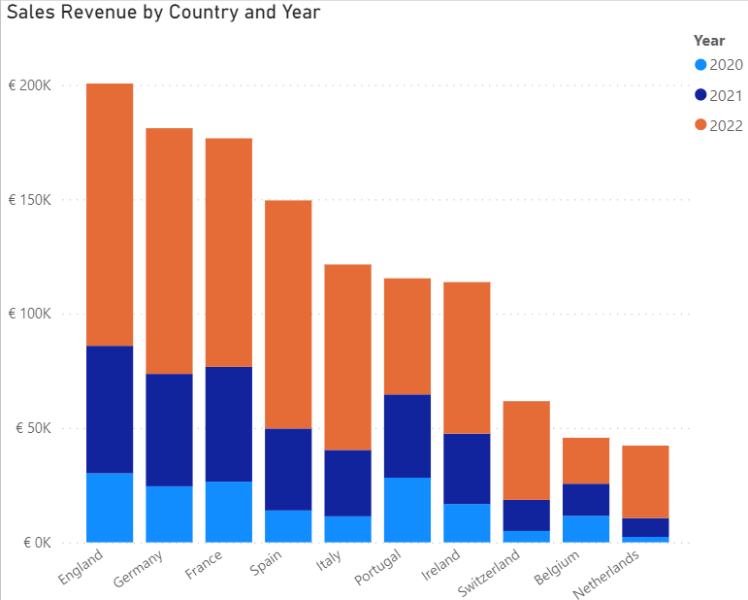
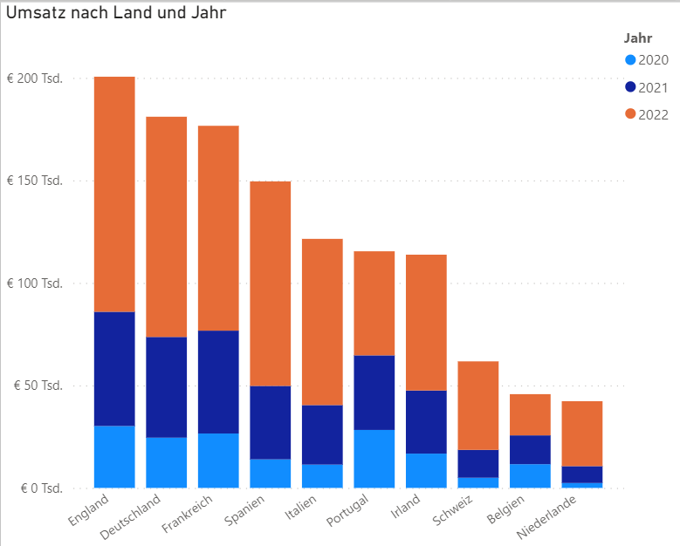
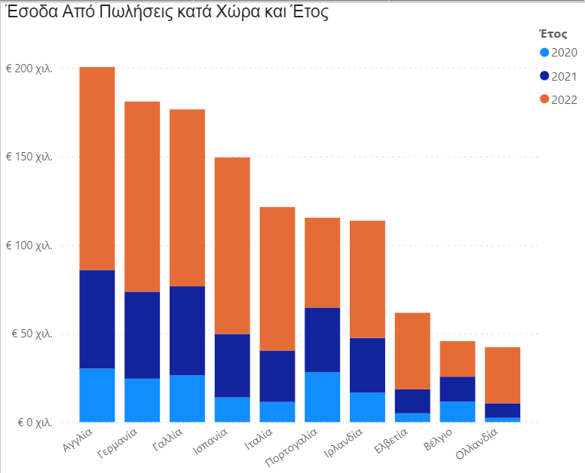
Data Translations

Slide 8
Agenda
Introduction to Building Multi-language Reports for Power BI
Localizing Report Labels using the UserCulture Function
Getting Started with Translations Builder
Creating and Testing Metadata Translations
Using the Localized Labels Strategy To Translate Report Labels
Implementing Data Translations using Dataset Field Parameters

Slide 9
Agenda
Introduction to Building Multi-language Reports for Power BI
Localizing Report Labels using the UserCulture Function
Getting Started with Translations Builder
Creating and Testing Metadata Translations
Using the Localized Labels Strategy To Translate Report Labels
Implementing Data Translations using Dataset Field Parameters

Slide 10
Adding Metadata Translations
You can add dataset translations into PBIX project file
You can add/manage dataset translations with datasets running in Power BI Service
Tabular
Editor
Power BI Desktop
PBIX Project File
Dataset
Custom Code using TOM
Tabular
Editor
Power BI Service
Premium Workspace
XMLA
Endpoint
Dataset
Custom Code using TOM

Slide 11
Developing an External Tool for Power BI Desktop
Power BI Desktop provides support for integrating external tools
External tool can be launched from Power BI Desktop
External tool can connect to dataset inside a PBIX project file
External tool can be designed to add and manage metadata translations
External tool must be programmed to use Tabular Object Model (TOM)
Local Desktop Setup on a Windows PC
Translations Builder
Power BI Desktop
Custom C# Code
Local Analysis Services Engine
Dataset
Tabular Object Model (TOM)
localhost:52686
XMLA Endpoint
.NET 6 Runtime

Slide 12
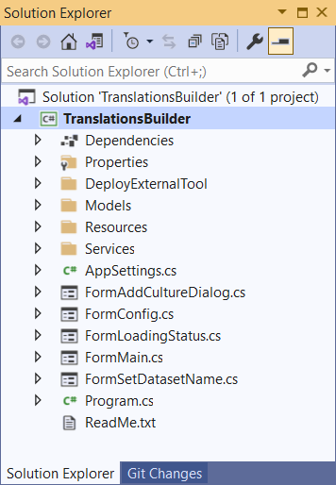
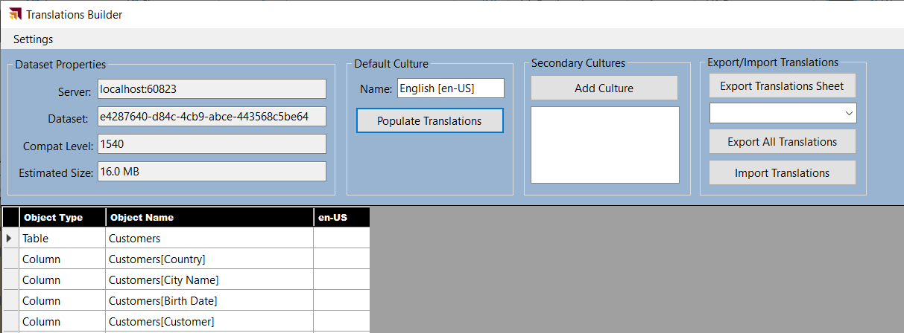
External Tool Developer Sample: TranslationsBuilder
.NET application using C# which programs TOM to automate localization tasks
Provides code to populate translations of default culture
Provides code to add secondary cultures and populate their translations
Calls to Microsoft Translator Service to create starting set of translations for each language

Slide 13
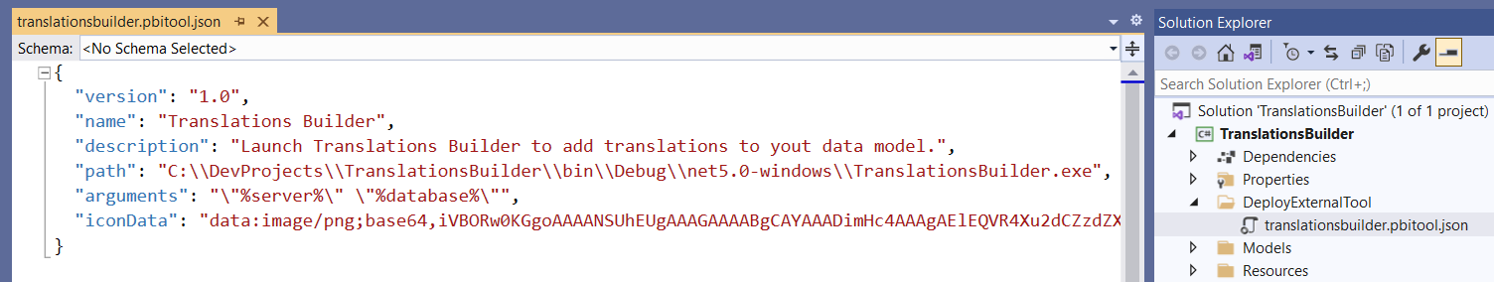
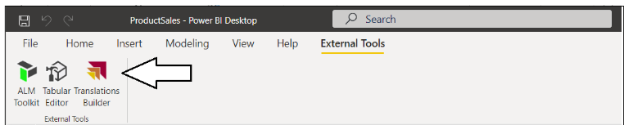
Deploying an External Tool
Deployment requires creating JSON file with *.pbitool.json extension
Deployment file (translationsbuilder.pbitool.json) must be copied to this folder
C:\Program Files (x86)\Common Files\Microsoft Shared\Power BI Desktop\External Tools
After a restart, Power BI Desktop should display tile on External Tools tab of ribbon

Slide 14
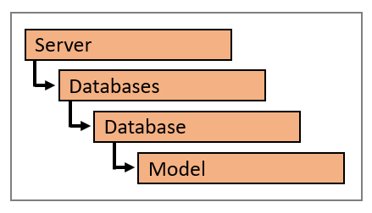
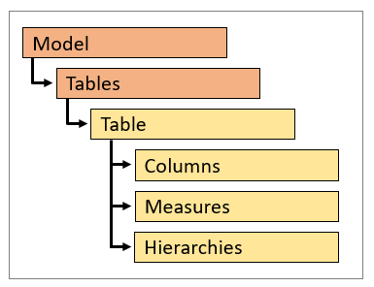
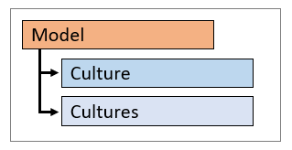
Tabular Object Model (TOM)
TOM is extension of Analysis Management Object (AMO) client library
TOM supports programming against Power BI datasets using XMLA protocol
Power BI dataset represented in TOM with a Database object
Data model inside dataset represented in TOM with Model object
Model object provides access to dataset objects
TOM provides support for adding/managing metadata translations
Dataset object types supporting localization include Table, Column, Measure and Hierarchy
Dataset object translation properties include Caption, Description and DisplayFolder
Model object contains Culture property and Cultures collection

Slide 15
Agenda
Introduction to Building Multi-language Reports for Power BI
Localizing Report Labels using the UserCulture Function
Getting Started with Translations Builder
Creating and Testing Metadata Translations
Using the Localized Labels Strategy To Translate Report Labels
Implementing Data Translations using Dataset Field Parameters

Slide 16
Agenda
Introduction to Building Multi-language Reports for Power BI
Localizing Report Labels using the UserCulture Function
Getting Started with Translations Builder
Creating and Testing Metadata Translations
Using the Localized Labels Strategy To Translate Report Labels
Implementing Data Translations using Dataset Field Parameters

Slide 17
Agenda
Introduction to Building Multi-language Reports for Power BI
Localizing Report Labels using the UserCulture Function
Getting Started with Translations Builder
Creating and Testing Metadata Translations
Using the Localized Labels Strategy To Translate Report Labels
Implementing Data Translations using Dataset Field Parameters

Slide 18
Summary
Introduction to Building Multi-language Reports for Power BI
Localizing Report Labels using the UserCulture Function
Getting Started with Translations Builder
Creating and Testing Metadata Translations
Using the Localized Labels Strategy To Translate Report Labels
Implementing Data Translations using Dataset Field Parameters

Slide 19
How to Package Reports and Datasets for Distribution
Use simplest approach based on single PBIX file
Use a shared dataset approach with multiple PBIX files
Use advanced tools to create and maintain dataset definition in .BIM file format
Guidance for localizing Power BI datasets and reports will be the same in all cases
Single PBIX Scenario
Shared Dataset Scenario
Advanced Data Modeling Scenario
Report Layout
Report Layout
Report Layout
(not used)
Report Layout
Dataset Definition
ProductSalesReport01.pbix
Dataset Definition
ProductSalesReport01.pbix
Dataset Definition
ProductSales.pbix
Report Layout
ProductSalesDataset.pbix
Report Layout
productsales.model.bim
ProductSalesReport02.pbix
ProductSalesReport02.pbix

Slide 20
Preparing a Power BI Report for Localization
Plan localization from the start
Much harder to work with pre-existing PBIX created without localization in mind
Plan for content growth
Some languages have content wider than English
Include padding for translated content
Avoid report design techniques that do not support localization
Don’t add literal text in visuals, textboxes or buttons
Don’t display page tabs - their display names cannot be localized

Slide 21
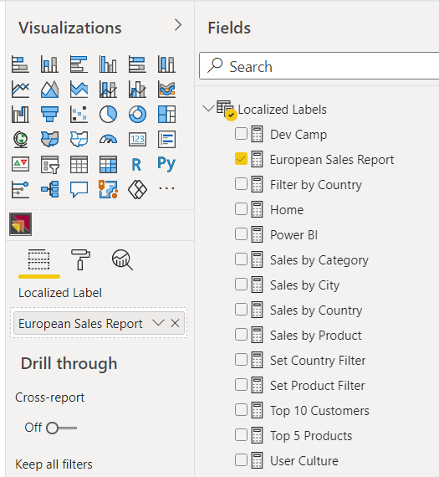
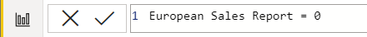
Adding Measures to the Localized Labels Table
Create a new table in data model named Localized Labels
Add a new measure for any string content that needs to be localized
Set measure expressions to 0

Slide 22
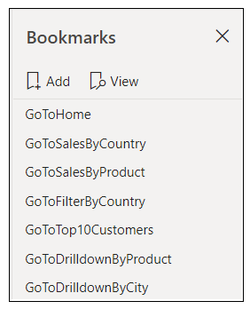

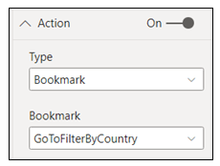
Designing Navigation
Page tabs do not support localization – they should be hidden from user
Page-to-page navigation can be designed with shapes and bookmarks
Shape should be configured as transparent and with action to apply bookmark
Shape
Localized Label

Slide 23
Adding Metadata Translations
You can add dataset translations into PBIX project file
You can add/manage dataset translations with datasets running in Power BI Service
Tabular
Editor
Power BI Desktop
PBIX Project File
Dataset
Custom Code using TOM
Tabular
Editor
Power BI Service
Premium Workspace
XMLA
Endpoint
Dataset
Custom Code using TOM

Slide 24
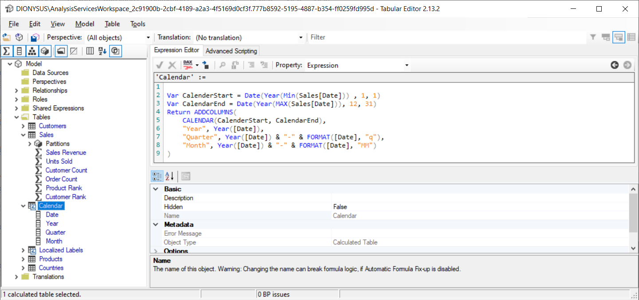
Working with Tabular Editor
Tabular Editor is external tool integrated with Power BI Desktop
Download from https://github.com/otykier/TabularEditor/
Provides control over advanced data modeling features
Provides Advanced Scripting features to automate development tasks

Slide 25
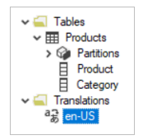
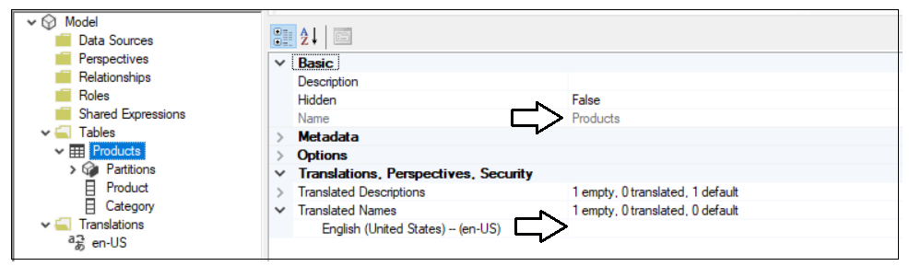
Understanding Cultures
Every dataset has a collection of one or more Culture objects
Each culture object based on a specific language and a specific user locale
Each new dataset is created with a single culture – this is the default culture
ProductSales.pbix has default culture of en-US for English in the United States
Every metadata translation must be added within scope of a culture

Slide 26
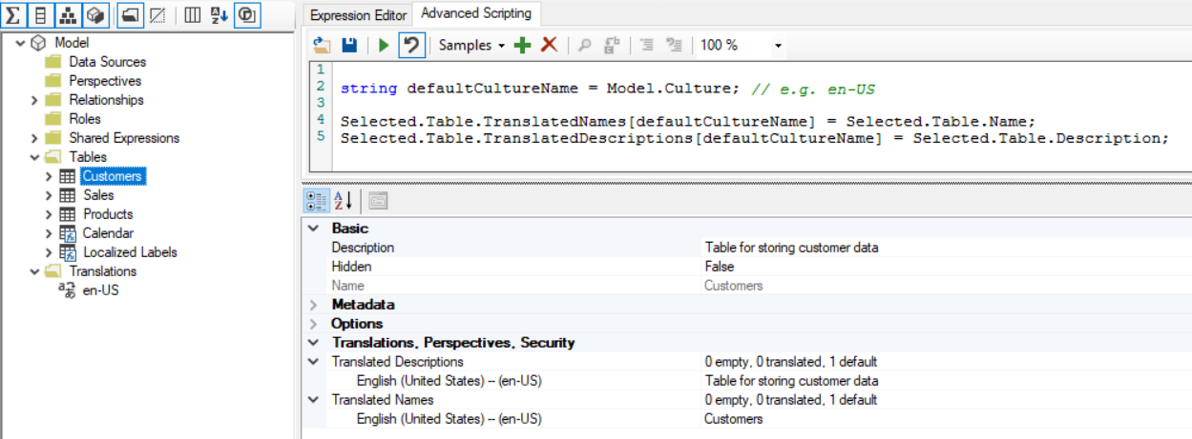
Populating Translations in the Default Culture
You start by adding metadata translations to the default culture
In a new dataset, default culture contains no metadata translations
You can add metadata translations by hand or by using Advanced Scripting
Remember to return to Power BI Desktop and execute Save command so your changes to the dataset definition are persisted into PBIX file

Slide 27
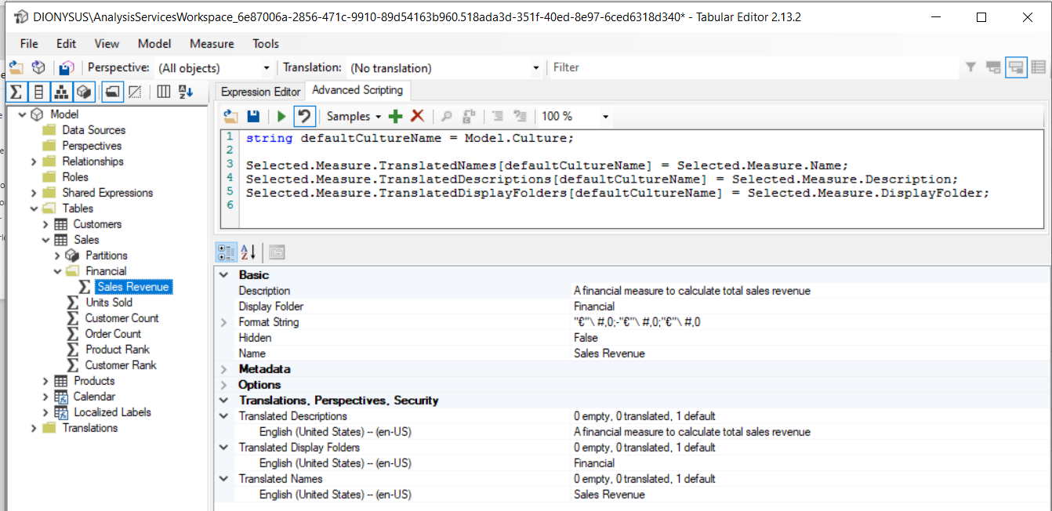
Adding Metadata Translations using Tabular Editor
Tabular Editor provides collection properties to add translations
Translated Names: used to add metadata translations for dataset object names
Translated Descriptions: used to add metadata translations for dataset object descriptions
Translated Display Folders: used to add translations for dataset object display folder names

Slide 28
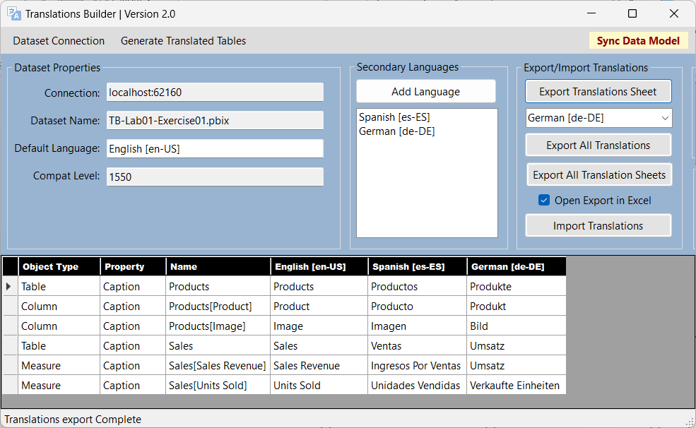
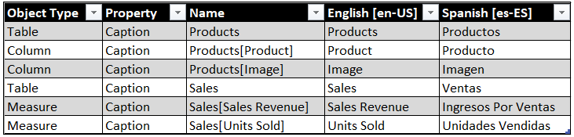
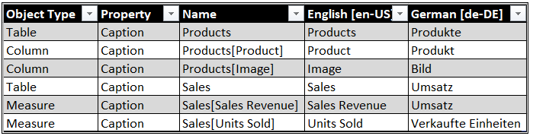
Human Workflow
Outbox
Project1-Translations-Spanish.csv
Export Translation Sheet
Project1-Translations-German.csv
Export Translation Sheet

Slide 29

Human Workflow
Outbox
Project1-Translations-Spanish.csv
Export Translation Sheet
Project1-Translations-German.csv
Export Translation Sheet
Inbox
Import Translation Sheet
Project1-Translations-Spanish.csv
Import Translation Sheet
Project1-Translations-German.csv

Slide 30
Enterprise Level Management
PBIX Project 1
Master
Translation
Sheet
PBIX Project 2
Export Operation
Import Operation

Slide 31
Enterprise Level Management
New PBIX
Project 1
Enterprise Master
Translation Sheet
Import Operation
Import Operation
New PBIX
Project 2
Import Operation
New PBIX
Project 3

Slide 32
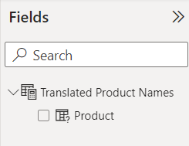
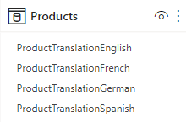
Field Parameters
column
selector

Slide 33
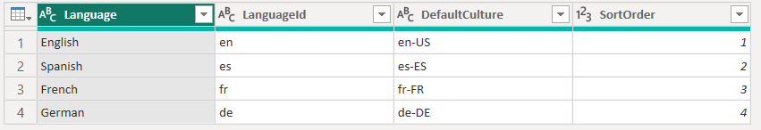
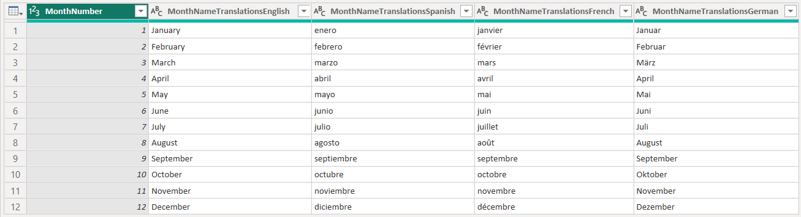
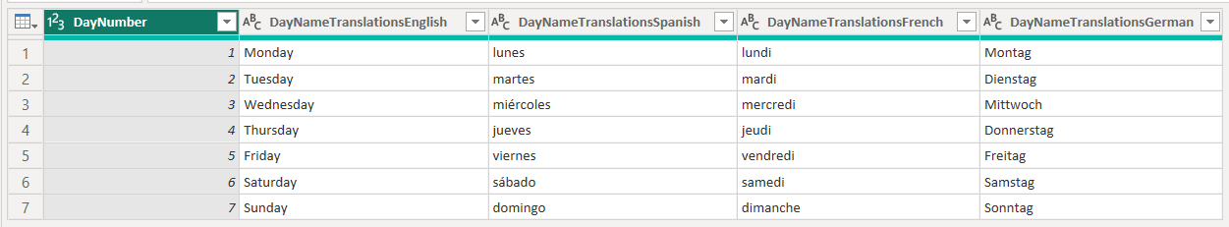
Languages
Power Query Transforms
Translated Month Names Table
Translated Day Names Table

